Slide 1
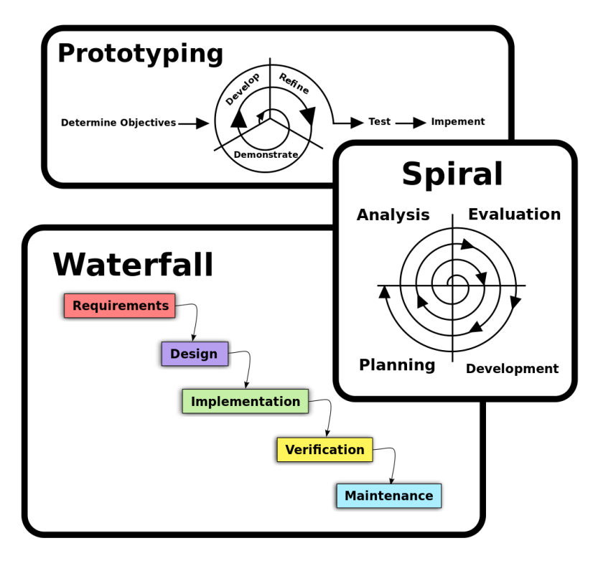
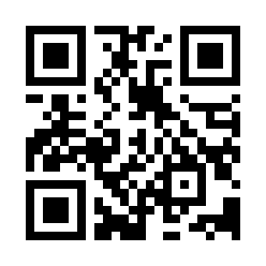
Software Development Models Quiz
https://bit.ly/3UdDNPb

